Slide 1
ParaLanczos:
A Scalable, Parallel Lanczos Algorithm for CUDA
Brian Tuomanen

Slide 2
Contents
Introduction
Motivation: Compressive Sensing
The Lanczos Algorithm
Usage and Implementation
Performance Tests
Ideas for the future

Slide 3
Introduction

Slide 4
Assumptions
Know some linear algebra / numerical analysis
Experience with C/C++ programming
Some experience with GPU or parallel programming (preferably CUDA)
Some MATLAB may be helpful

Slide 5
What is ParaLanczos?
Extract spectra (eigenvalues) from many “small” submatrices of a single dense positive semidefinite-symmetric matrix.
Most existing libraries are focused on eigenvalues from large matrices, or sparse matrices.
Written for Nvidia GPUs in CUDA
Designed specifically for mathematical / compressive sensing researchers who have access to a workstation with a GPU who want to study reduced isometry property / sensing matrices
Still many features to be added
Includes front-ends for MATLAB Parallel Computing Toolbox
Don’t have to write everything in C!
Uses some features only available in newer GPUs
Extensive use of “shuffle” commands for intra-thread communication
Licensed under LGPL 2.0

Slide 6
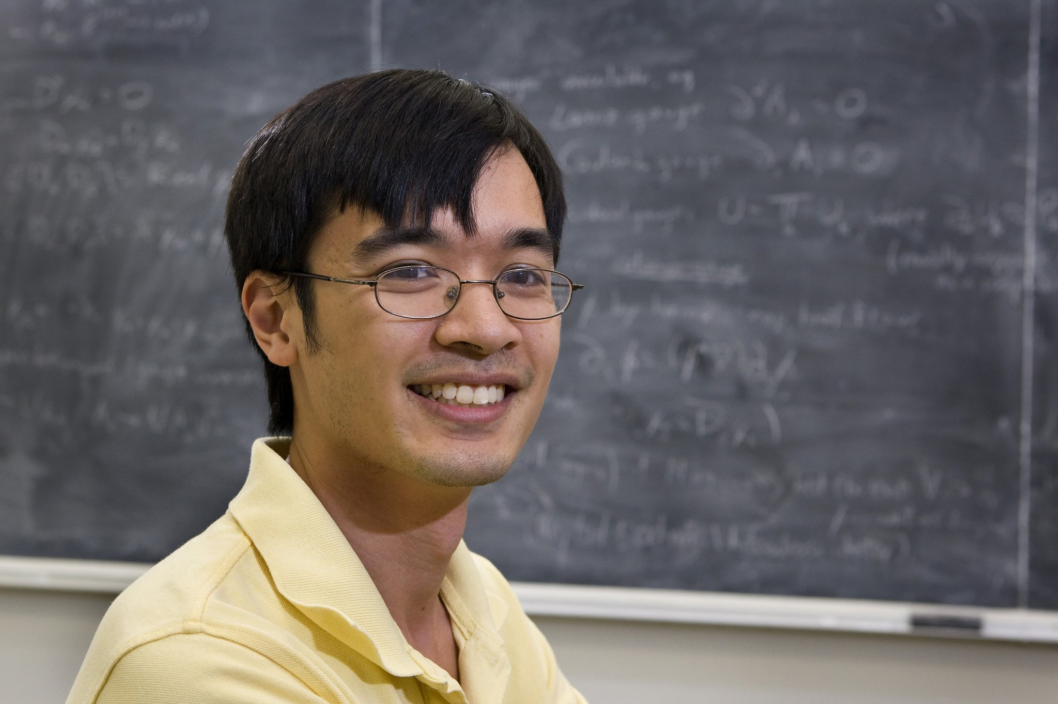

Compressive Sensing Overview (Motivation)
Terry Tao (Mathematics, UCLA)
Eric Candes (Statistics, Stanford)

Slide 7

Verify Sensing / RIP Matrices
We want a “short, fat” M x N matrix A (i.e., overcomplete with N >> M ) such that we can recover an M-dimensional input vector f from the corrupted measurement y:
$y=Af+e$ (e is noise)
For such a matrix A, we should be able recover f from the corrupted measurement y with convex optimization programming:
$$f=argmin_{g∈ℝ^{M}}|| y −A g ||_{ℓ_{1}}$$
We call matrices with such criteria sensing matrices!
These are useful for the field known as Compressive Sensing

Slide 8
But of what use is compressive sensing?
Applicable to any field where it would be nice to use fewer samples, such as for reconstruction of a signal, or for feature extraction for machine learning, e.g.:
MRI
Data Compression
Facial Recognition
See :
Ellenberg, Jordan. “Fill in the Blanks: Using Math to Turn Low-Res Datasets Into Hi-Res Samples.” Wired, February 2010.
M.Lustig, D.Donoho, J. Santos, J. Pauly. “Compressed Sensing MRI: A look at how CS can improve on current imaging techniques.”, Signal Processing Magazine, March 2008.

Slide 9
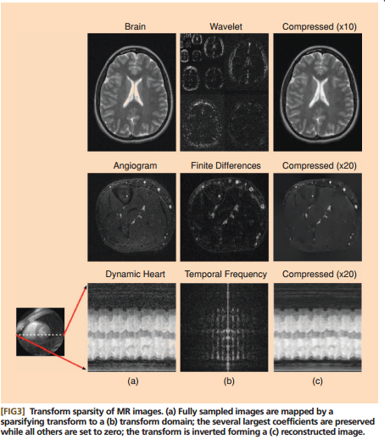


The fruits of Sensing Matrix $ℓ_{1}$ minimalization….

Slide 10

This sounds great. But what criteria need apply to A in order to be a sensing matrix?
A sensing matrix A must have a Reduced Isometry Property (RIP)
E. J. Candes and T. Tao, ”Decoding by Linear Programming,” IEEE Trans. Inf. Th., 51(12): 42034215 (2005)
Consider a M x N matrix $A=\left[φ_{1} φ_{2} …φ_{N}\right].$ This is said to have the S-restricted isometry property for constant $δ_{S}$ (where S is a positive integer, and $0<δ_{S}<1$) if for every matrix of the form$A_{S}=[φ_{1}^{′} φ_{2}^{′} …φ_{S}^{′}]$ (where ${\{φ}_{i}^{′} :i=1 …S\}⊂ \{φ_{i} :i=1 …N\}$) we have the following inequality for every $x∈ℝ^{S}$:
$$\left(1 −δ_{S}\right){\left|\left|x\right|\right|}^{2}≤{\left|\left|A_{S}x\right|\right|}^{2}≤\left(1+δ_{S}\right){\left|\left|x\right|\right|}^{2}$$
For the $ℓ_{1}$ minimization trick to work, we have to have particular values for $S$ and $δ_{S}$ in relation to the dimension M :
For most intents and purposes, $S≈\frac{M}{2}$ and $δ_{S}≈0.5$ will work.

Slide 11

Notice:
$$||A_{S}x||^{2}={\left(A_{S}x\right)}^{∗}\left(A_{S}x\right)=x^{∗}A_{S}^{∗}A_{S}x$$
Also notice: $A_{S}^{∗}A_{S}$ is just the Gramian matrix of $A_{S}:$
$$\left[\begin{matrix}{φ_{1}^{′}}^{∗}φ_{1}′ & ⋯ & {φ_{1}^{′}}^{∗}φ_{S}′ \\ ⋮ & ⋱ & ⋮ \\ {φ_{S}^{′}}^{∗}φ_{1}′ & ⋯ & {φ_{S}^{′}}^{∗}φ_{S}′\end{matrix}\right]$$
… which itself is a submatrix of the Gramian of A, $A^{∗}A$ :
$$\left[\begin{matrix}{φ_{1}^{∗}}^{ }φ_{1} & ⋯ & {φ_{1}^{ }}^{∗}φ_{S} \\ ⋮ & ⋱ & ⋮ \\ {φ_{S}^{′}}^{ }φ_{1} & ⋯ & {φ_{S}^{ }}^{ ∗}φ_{S} \end{matrix}\right]$$

Slide 12

Also notice: since Gramians are positive semi-definite matrices, checking the RIP property of $A_{S}$ is equivalent to checking the maximum and minimum eigenvalues of $A_{S}^{∗}A_{S}$
Thus, we can just check all the submatrices of $A^{∗}A$ of a size S x S to see if it is an RIP matrix!
Q: … but that’s an NP-complete problem and we will have to check the eigenvalues of $\left(\begin{matrix}N \\ S\end{matrix}\right)$ matrices each of size S x S!! Isn’t there a faster way?
A: No. No, there is not. That is the only known way to verify whether a matrix is RIP; to check all of these submatrices.
A. S. Bandeira, E. Dobriban, D. G. Mixon, W. F. Sawin, ”Certifying the Restricted Isometry Property is Hard,” IEEE Trans. Inf. Th., 59(6): 3448-3450 (2013)
Thus, ParaLanczos!

Slide 13
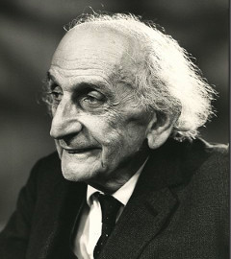
Matrix Tridiagonalization and the Lanczos Algorithm
Cornelius Lanczos

Slide 14

For any symmetric matrix, we always can find a similar matrix that is tridiagonal, i.e. a tridiagonal matrix with the same exact spectra.
It is much faster to find a similar tridiagonal matrix, and then find the eigenvalues
What is a tridiagonal matrix? One of this form:
$$\left[\begin{matrix}a_{1} & b_{1} & 0 & … & 0 \\ b_{1} & a_{2} & b_{2} & & ⋮ \\ 0 & b_{2} & a_{3} & ⋱ & 0 \\ & & & & b_{M−1} \\ 0 & … & 0 & b_{M−1} & a_{M}\end{matrix}\right]$$

Slide 15
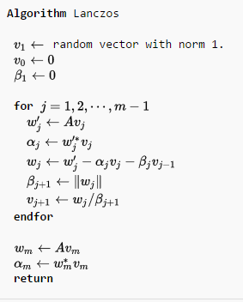
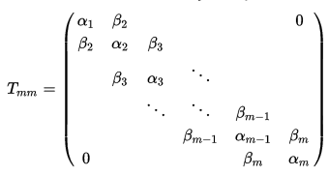
Lanczos algorithm: Wikipedia edition

Slide 16
… and about the eigenvalues?
There are various ways to get the eigenvalues out of a tridiagonal matrix. Two camps:
Methods based on Gaussian elimination of the tridiagonal matrix:
QL factorization
QR factorization
These are simpler, but not parallelizable
Methods based finding the zeroes of the characteristic polynomial of the tridiagonal matrix:
Method of Bisections
W. Barth (1967), I.S. Dhillon (1997)
This is parallelizable, but more tricky.
Currently, ParaLanczos uses QL factorization (serial)
Parallel Method of Bisections partially implemented

Slide 17
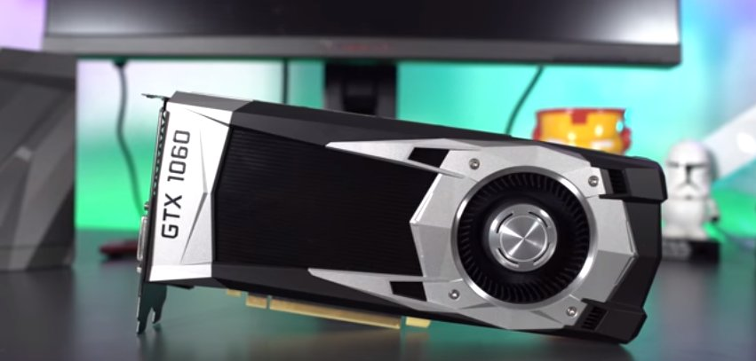
Usage and Implementation

Slide 18

Main CUDA Kernels
POS_SYM_SUBMATRIX_KER
POS_SYM_SUBMATRIX_KER2 (Achieves full-warp occupancy)
Parameters:
double *mat: input, pointer to main positive-symmetric matrix. (Row-major or column-major doesn’t matter, it’s symmetric)
int n: input, size of matrix, where “mat” is n x n
int *subIndex: input, pointer to an array of indices for each submatrix, stored iteratively. Length of total subIndex array should be divisible by 4 x 32. (While the length of each submatrix index is subn, see below.)
int subn: input, size of the submatrices we are checking (each submatrix is of size subn x subn). Note that this must be of size 4, 8, 16, 32, 64 or 128 for the first kernel, and only up to 64 in the second.
double *Eigenvalues: output pointer, eigenvalues of each submatrix, stored iteratively
double *DetMat: output pointer, values of the determinants for each submatrix
Double *Eigerror: output pointer, stores error values associated with the computation of the spectra of the respective submatrix

Slide 19

Grid and block size parameters:
For the first kernel: grid size must be total # of submatrices to evaluate, block size must be $\log_{4}{(subn)}$:
POS_SYM_SUBMATRIX_KER <<< TotalNumberOfSubmatrices, log4(subn) >>> ( … )
For the second kernel: grid size must be the length of subIndex divided by (32 x 4), and the block size must be 32.
POS_SYM_SUBMATRIX_KER2 <<< subIndexLength / (32 x 4), 32>>> ( … )
Notice: We do not pass the subIndex length into the kernel. This is inferred directly through the grid/block size and subn input. (Similarly with the pointers Eigenvalues, DetMat, Eigerror….)

Slide 20
Implementation
Difference between first and second kernel:
First kernel handles only a single submatrix in each grid
Leaves “dangling threads” in warps.
.. but is more flexible in terms of the length of subIndex
Second kernel handles as many submatrices a possible within warp
To have full-occupancy within a warp all 32 threads must be used

Slide 21
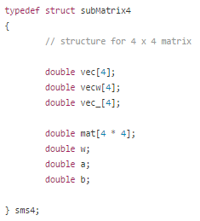
These submatrices are distributed among threads into the following matrix structure (note the size-4 arrays, which are used in the Lanczos algorithm):
Each thread handles an array of these structures of length subn / 4. That is to say: each CUDA thread is responsible for processing a subn x 4 “slice” of a submatrix

Slide 22
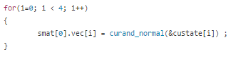
An initial random vector is generated via the CuRAND library, and stored as such in the first element of our sms4 array:
We then normalize this vector across the threads. This requires intra-thread communication, so we use “shuffle” commands. Note we use similar tricks throughout the code:
Shuffle commands can only work within a single warp, so this is the philosophy behind keeping the blocks of size 32 (or less).

Slide 23
“Shuffle” commands only support 32-bit variables, so we have to implement our own versions for 64-bit doubles:
PTX assembly is used to perform bitwise partition, reconstruction of
doubles

Slide 24
If we look at the Lanczos algorithm, it’s just a series of linear operations: matrix multiplication, dot products, and norms.
Using shuffles, we can can reduce these operations to operate in O(log N) and O(N log N) time.
The use of shuffles and having threads operate on 4 x 4 matrices allows us to scale the algorithm, reducing latency in the computation of our submatrices

Slide 26
After each step in the Lanczos algorithm, we have new alpha and beta values (i.e., values for the tridiagonal). We temporarily store these using shared memory on the GPU
Of course, we will have to restrict this so only a single thread will write to the shared memory

Slide 27
Finally, for the coup-de-grace, we get the eigenvalues out of the alpha and beta values, and then store them in the global memory.
We use a modified QL method from EISPACK for this, TQLRAT:
The eigenvalues are then stored in alpha. We then store them into global memory. Notice the work is partitioned so that each thread loads values into the global memory:

Slide 28
Some Performance Tests

Slide 29
A little MATLAB script I made for doing speed tests on CPU and GPU

Slide 30
Basis of Comparison
All tests run on a Linux Workstation with the following specs:
Ubuntu 14.04
8-core, 2011 Intel Xeon Processor
32 GB RAM
Nvidia GeForce GTX Titan X (2014)
3072 CUDA Cores
12 GB memory
MATLAB 2015A with Parallel Computing Toolbox

Slide 31
Speed tests using 4 x 4 submatrices
# submatrices | 8-Core Xeon | Kernel 1 | Kernel 2
16,000 | 1.80 s | 1.10 s | 1.16 s
32,000 | 2.99 s | 1.14 s | 1.19 s
256,000 | 20.52 s | 1.79 s | 1.41 s
1,280,000 | 100.04 s | 4.80 s | 2.46 s

Slide 32
Speed tests using 16 x 16 submatrices
# submatrices
32,000
64,000
128,000
256,000
1,280,000
8-Core Xeon | Kernel 1 | Kernel 2
18.75 s | 1.32 s | 1.40 s
37.06 s | 1.58 s | 1.66 s
73.92 s | 2.12 s | 1.78 s
147.00 s | 3.20 s | 3.18 s
804.49 s | 11.81 s | 11.24 s

Slide 33
Speed tests using 64 x 64 submatrices
# submatrices | 8-Core Xeon | Kernel 1 | Kernel 2
16,000 | 32.38 s | 3.21 s | 3.11 s
32,000 | 62.58 s | 3.36 s | 5.10 s
256,000 | 255.32 s | 10.18 s | 18.28 s

Slide 34
Ideas for the Future
For compressive sensing: Only interested in maximum and minimum eigenvalues of submatrices
Tridiagonal matrices have a closed form solution whose computation can be parallelized
R.A. Usmani. “Inversion of a tridiagonal Jacobi matrix.” Linear Algebra and its Applications, 1994
Instead of extracting all eigenvalues, can estimate maximum eigenvalue from original matrix, and minimum from the inverse
Faster?
Implement a Parallelized Barth Method of Bisections to find eigenvalues
???

Slide 35
Thank you!
Please see https://www.github.com/btuomanen/ParaLanczos for further information

Slide 36
FIN

